Slide 1
2003-2005
Sales Data Analysis
Jane Shan

Slide 2
1
BACKGROUND
2
TERRITORY ANALYSIS
CONTENT
3
SALES PREDICTION
4
POTENTIAL TERRITORY

Slide 3

Background
01
To provide insights based on the dataset to the senior management group before their annual strategy meeting.
Specifically, 2003 Q1 - 2005 Q2 YOY sales performance in different product line of all territory was examined to find the best potential product in each region
Findings of the analysis is used to aid the performance prediction in 2006.
Based on the analysis above to find the best potential territory

Slide 4

DEFINITION
03
MSRP
TERRITORY
DISCOUNT
MSRP: Manufacturer's suggested retail price
NA: North America
EMEA: Europe, the Middle East and Africa
APAC: Asia Pacific (
Discount = (Sale Price – MSRP) * Quantity Ordered

Slide 5
TERRITORY ANALYSIS
02
Product analysis
Sales vs Discount
Best potential product

Slide 6
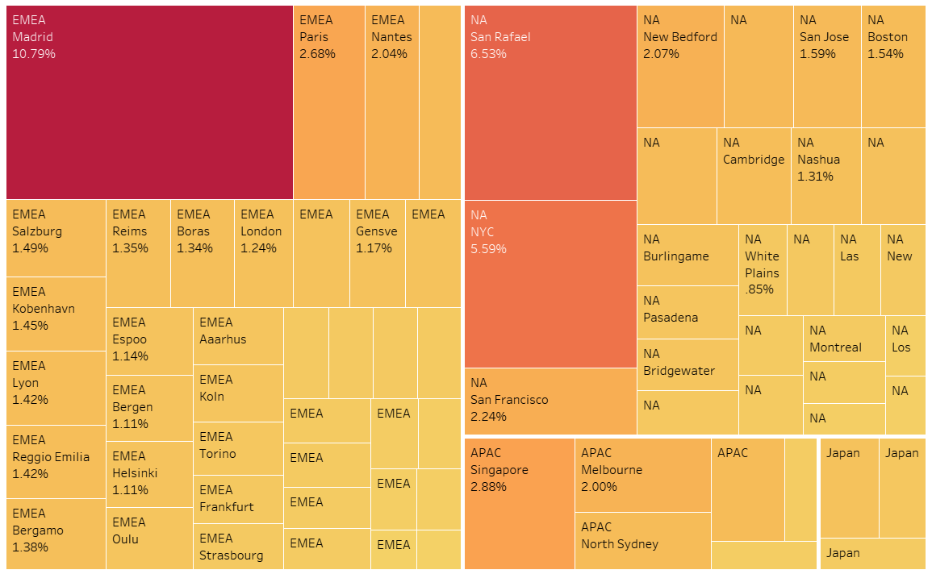
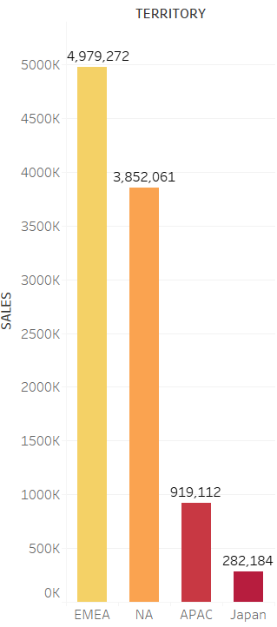
Sales Map Infographic
2003 Q1 - 2005 Q2 YOY sales performance in different product line of all territory was examined to find the best potential product in each region

Slide 7
TERRITORY-EMEA
Overview
The EMEA territory total sale for 2004 was 44% higher than 2003. And the 2004 quantity number is 43% higher than 2003.
Main Client : Euro shopping channel
Main City: Madrid

Slide 8


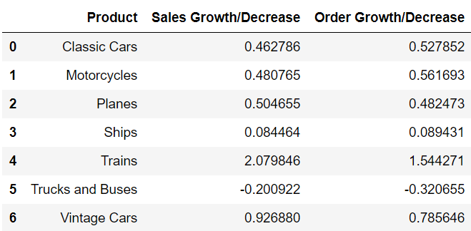
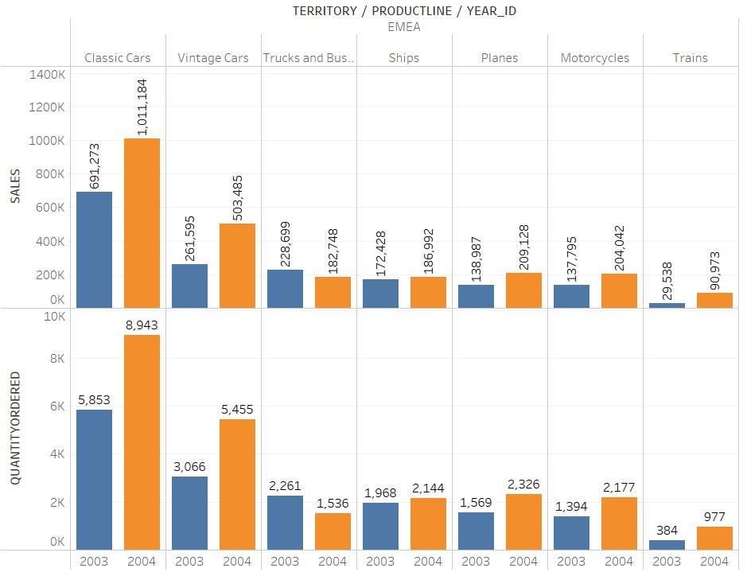
TERRITORY-EMEA
Product Analysis
EMEA territory 2003- 2004 Product sales data
Product line:
Trucks and Buses: sale for 2004 was 20% lower than 2003. And the 2004 quantity number is 32% lower than 2003.
Trains: sale for 2004 was 207% higher than 2003. And the 2004 quantity number is 154% higher than 2003.
Overall, all product lines have grown, except for Trucks and Buses. The sales of Trucks and Buses decreased 20%, it is necessary to pay attention to marketing strategies in the next year, such as discount to enhance market competitiveness.

Slide 9

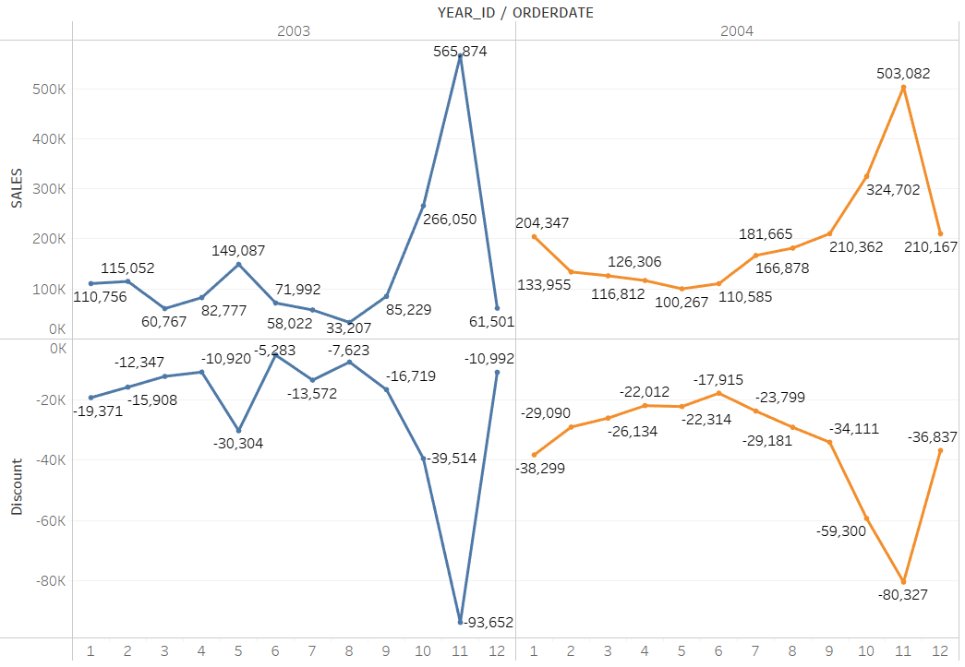
TERRITORY-EMEA
PHOTO FROM PIXABAY
Sales vs Discount
Look at the trend of Sales vs Discount in EMMA territory from 2003 to 2004. It is clearly that sales are highly positive related with discount. Sales peaks in 2003 May and November and sales peak in 2004 November are the best proof.

Slide 10
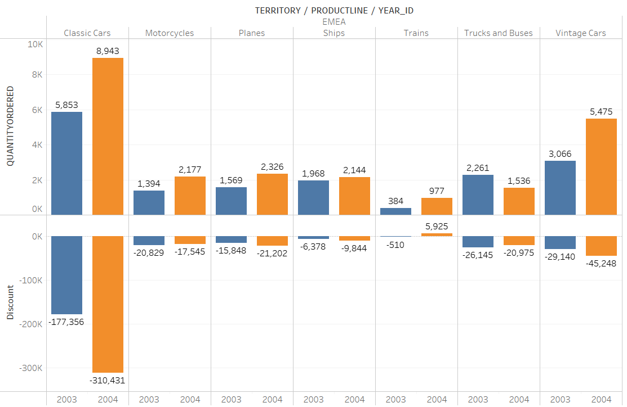
TERRITORY-EMMA
Sale vs Discount
Meanwhile, products 'order number also positive relative with discount but not as obvious as NA territory.
Both Classic Cars and Ships’ discount growth greater than sales growth. Classic Cars increase 75% discount, but order number only increase for 52%. Ships increase 54% discount, but order number only increase for 8%.
Both Planes and Vintage’ growth rate greater than discount rate. Compared with Planes which discount has increased 30%, orders have increased 48%, Vintage Cars have relatively large growth potential. As discount increases for 55%, it’s order number can increase to 78%.
It is clear that in EMEA territory Vintage Cars have the best potential growth space.

Slide 11
SUMMARY
The EMEA territory total sale for 2004 was 44% higher than 2003. And the 2004 quantity number is 43% higher than 2003. All product lines have grown, except for Trucks and Buses. The sales of Trucks and Buses decreased 20%, it is necessary to pay attention to marketing strategies in the next year, such as discount to enhance market competitiveness.
Discount is the key variable for maximum revenue.
In EMMA territory Vintage Cars have the best potential growth space.
Business is the human activity related to material things. It is necessary for civilization.

Slide 12
TERRITORY-NA
Overview
The NA territory total sale for 2004 was 34% higher than 2003. And the 2004 quantity number is 39% higher than 2003.
Main Client : Mini Gifts distributors Ltd
Main City: San Rafael

Slide 13
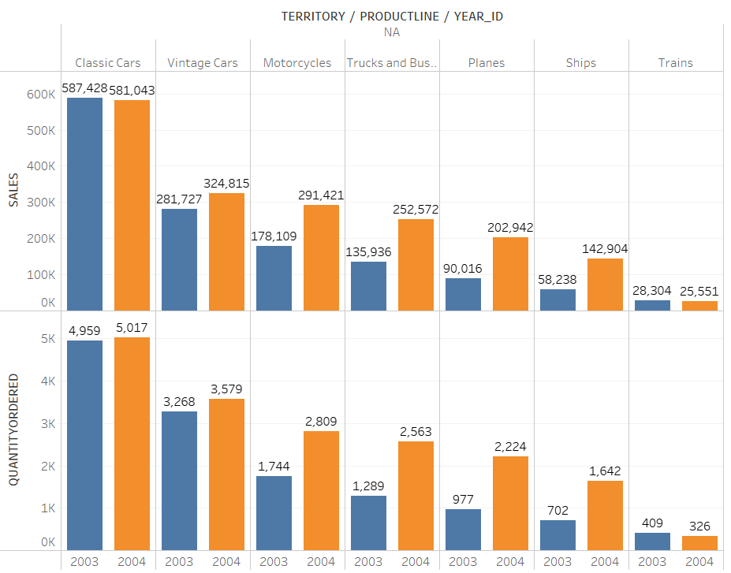
TERRITORY-NA
Product Analysis
NA territory 2003- 2004 Product sales data
Product line:
Classic Cars: sale for 2004 was 1% lower than 2003. And the 2004 quantity number is 5.6% higher than 2003.
Trains: sale for 2004 was 10% lower than 2003. And the 2004 quantity number is 17% lower than 2003.
Overall, all product lines have grown, except for classic cars and trains. Although the sales of classic car have dropped, it has only dropped by 1%, sales have increased by 6%. So that it is feasible to reduce the unit price in exchange for more sales and thus increase market share. The sales of train decreased more, it has 10%. For train, it is necessary to pay attention to marketing strategies in the next year, such as discount to enhance market competitiveness.

Slide 14
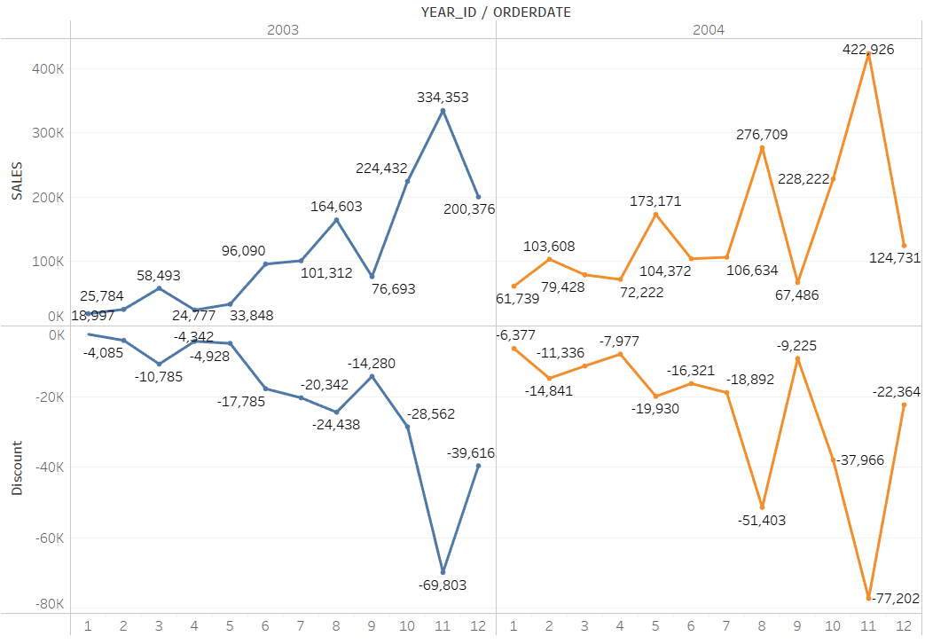
TERRITORY-NA
PHOTO FROM PIXABAY
Sales vs Discount
Look at the trend of Sales vs Discount in NA territory from 2003 to 2004. It is clearly that sales are highly positive related with discount: Two sales peaks (November and August) in 2003 and 2004 indicated that high sales always accompanied with high discounts.

Slide 15
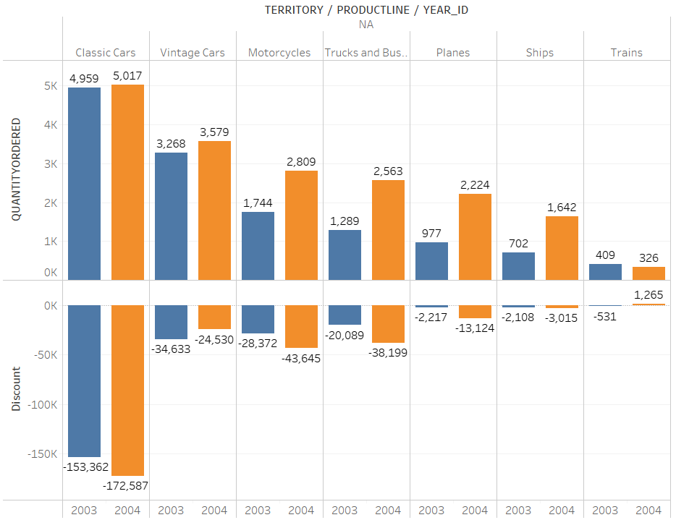
TERRITORY-NA
Sale vs Discount
Meanwhile, all products 'order number also positive relative with discount.
Classic Cars increase 10% discount, but order number only increase for 1%. Motorcycles increase 54% discount, but order number only increase for 61%.
Overall, indicates that higher order number, the less room for improvement. Order number increasement of main products is limited and has tend to be stable accompanied with increased discount. While, ships have relatively large growth potential. As discount increases for 49%, it’s order number can increase to 134%.
It is clear that in NA territory ship has the best potential growth space.

Slide 16
SUMMARY
The NA territory total sale for 2004 was 34% higher than 2003. And the 2004 quantity number is 39% higher than 2003.
all product lines have grown, except for classic cars and trains. For classic cars it is feasible to reduce the unit price in exchange for more sales and thus increase market share. For train, it is necessary to pay attention to marketing strategies in the next year.
Discount is the key variable for maximum revenue.
In NA territory Ships has best growth potential.
Business is the human activity related to material things. It is necessary for civilization.

Slide 17
TERRITORY-APAC
Overview
The APAC territory total sale for 2004 was 16% lower than 2003. And the 2004 quantity number is 14% lower than 2003.
Main Client : Australian collector co
Main City: Singapore

Slide 18
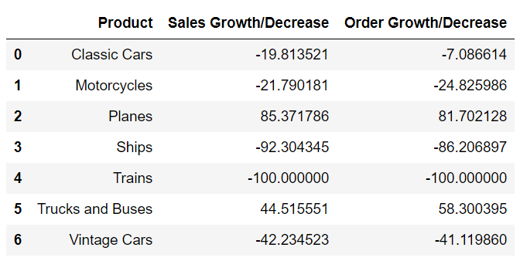
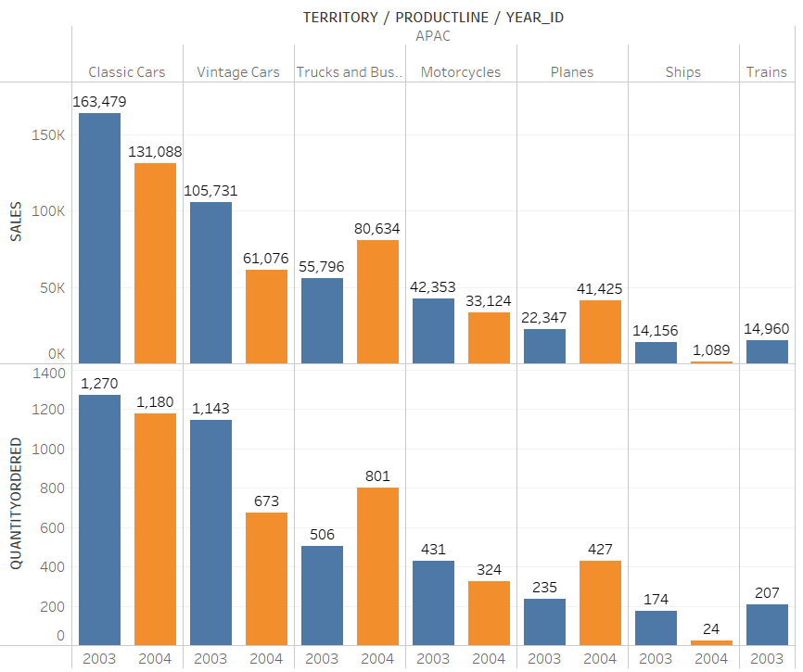
TERRITORY-APAC
Product Analysis
APAC territory 2003- 2004 Product sales data
Overall, all product lines decrease, except for Planes and Trucks and Buses. Among them, what needs to be taken seriously is that the sales of the train in 2004 is 0, and the sales of the ship and Vintage car also fall sharply. It is necessary to pay attention to marketing strategies in the next year, such as discount to enhance market competitiveness.

Slide 19
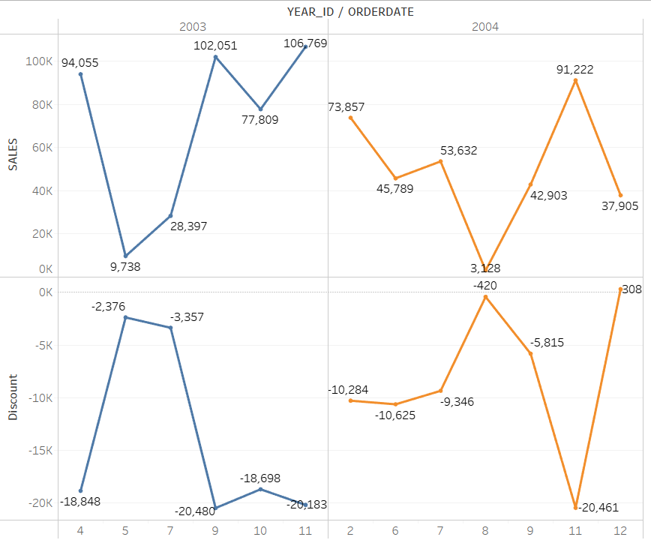
TERRITORY-APAC
PHOTO FROM PIXABAY
Sales vs Discount
Look at the trend of Sales vs Discount in APAC territory from 2003 to 2004. The trend between discount and sales become very sharp, so it is clearly that discount is extremely important in this area. The sales peak corresponds to discount valley in 2003 April, September and November and in 2004 February, July and November. The discount valley corresponds to the sales valley in 2003 May and July and in 2004 August and December.

Slide 20
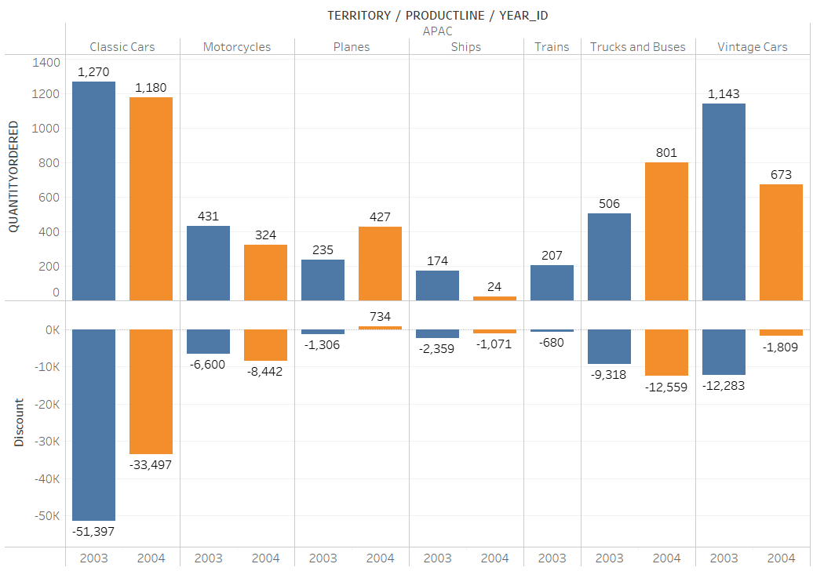
TERRITORY-APAC
Sale vs Discount
Meanwhile, products' order number also strong relative with discount. Both Classic Cars and Vintage Cars’ orders are decreased by the impact of discount reduction 7%- 40%. But Classic cars' impact is relatively small. Discount decrease for 34% only lead its order decrease for 7% which means this product’s order number is relatively stable, less growth space.
Vintage Cars and trucks and buses receive large impact. For Vintage cars, discount decrease 85% leads orders decrease 40%. For trucks and buses, discount increase 34% leads 58% orders' increase.
Planes' large increasement speed cannot be ignored, which is 81% higher than 2003 and 156% less discount than 2003.
It is clear that in APAC territory Planes, Trucks and Buses have large growth potential.

Slide 21
SUMMARY
The APAC territory total sale for 2004 was 16% lower than 2003. And the 2004 quantity number is 14% lower than 2003. All product lines decrease, among them what needs to be taken seriously is that the sales of the train in 2004 is 0, and the sales of the ship and Vintage car also fall sharply.
Discount is the key variable for maximum revenue.
In APAC territory Planes, Trucks and Buses have large growth potential
Business is the human activity related to material things. It is necessary for civilization.

Slide 22
TERRITORY-JAPAN
Overview
The Japan territory total sale for 2004 was 112% higher than 2003. And the 2004 quantity number is 107% higher than 2003.
Main Client : Tokyo collectables Ltd
Main City: Minato-Ku

Slide 23
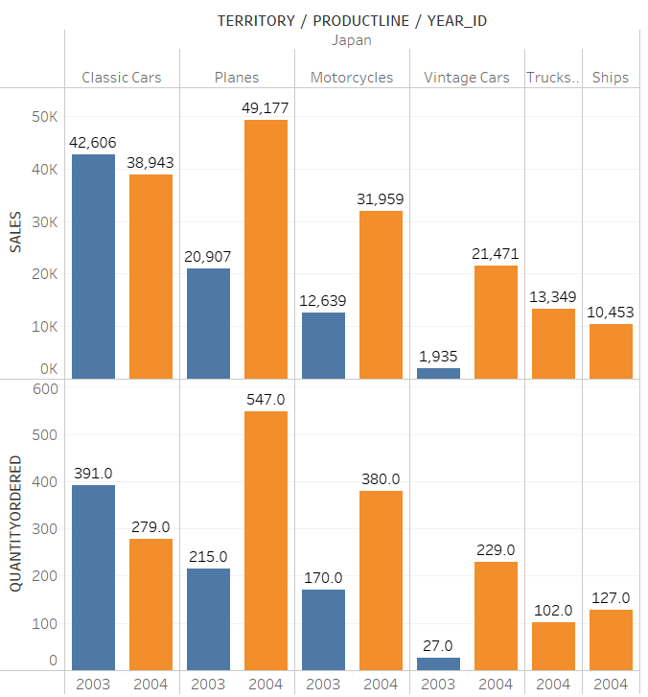
TERRITORY-JAPAN
Product Analysis
Japan territory 2003- 2004 Product sales data
Product line:
Classic Cars: sale for 2004 was 8% lower than 2003. And the 2004 quantity number is 28% lower than 2003.
Planes: sale for 2004 was 135% higher than 2003. And the 2004 quantity number is 154% higher than 2003.
Motorcycles: sale for 2004 was 152% higher than 2003. And the 2004 quantity number is 123% higher than 2003.
Vintage cars: for 2004 was 1000% higher than 2003. And the 2004 quantity number is 714% higher than 2003.
Overall, all product lines have grown, except for classic cars. Although the sales of classic car have dropped, the drop percent is small, just 8%. Which means this product is relatively stable in Japan market. Another products planes, motorcycles and Vintage cars have 1x increasement, show large market potential. Trucks and Ships are lack of past year data, but compare with other territory, it has good sales performance.

Slide 24
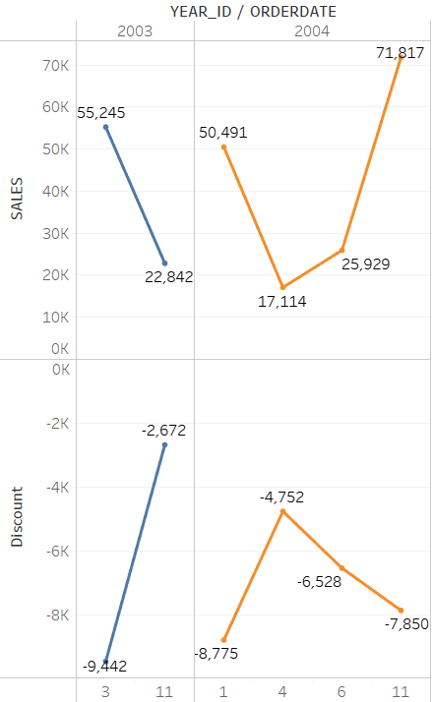
TERRITORY-JAPAN
PHOTO FROM PIXABAY
Sales vs Discount
Look at the trend of Sales vs Discount in Japan territory from 2003 to 2004. It is clearly that sales are highly positive related with discount. The sales peak corresponds to discount valley in 2003 March and in 2004 January and November. The discount valley corresponds to the sales valley in 2003 November and in 2004 April.

Slide 25
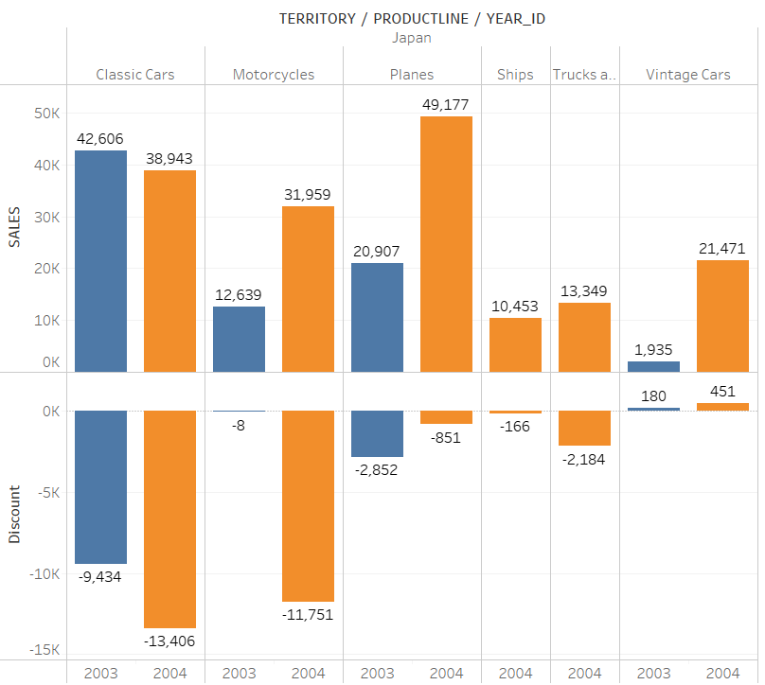
TERRITORY-JAPAN
Sale vs Discount
Meanwhile, all products 'order number also relative with discount.
Classic Cars increase 42% discount, but orders decrease for 8%. Which indicates that less room for improvement.
While, Planes have relatively large growth potential. As discount decrease for 70%, it’s order number can still increase to 135%. Vintage cars' order increase for 1000% , but discount decrease for 150%, show large market potential
It is clear that in Japan territory Planes and Vintage cars have the best growing potential

Slide 26
SUMMARY
The Japan territory total sale for 2004 was 112% higher than 2003. And the 2004 quantity number is 107% higher than 2003. All product lines have grown, except for classic cars. But the drop percent is small, just 8%. Which means this product is relatively stable in Japan market.
Planes, motorcycles and Vintage cars have 1x increasement, show large market potential.
Discount is the key variable for maximum revenue.
In Japan territory Planes and Vintage cars have the best growing potential
Business is the human activity related to material things. It is necessary for civilization.

Slide 27
SALES PREDICTION
03
2005 Q3 -2006 Q4

Slide 28
SALES PREDICTION
1
METHOD AND TOOL
3
Confidence Interval (95%)
The confidence level represents the frequency (i.e. the proportion) of possible confidence intervals that contain the true value of the unknown population parameter
The higher the confidence level, the wider the predicted interval and the lower the precision
Tableau Analysis (forecast)
2
IMPORTANT FEATURE FOR SALES PREDICTION
Year | ATTR | SALES
2003 | Actual | 3,516,979.54
2004 | Actual | 4,724,162.60
2005 | Estimate | 5,243,241.11
2006 | Estimate | 6,197,075.23
Discount (PRICEEACH-MSRP)
Order Date
Country, city
Product line, Product code

Slide 29
POTENTIAL TERRITORY
04
Japan

Slide 30
POTENTIAL TERRITORY-JAPAN
112%
Based on 2003-2004 data
Japan has the highest sales growth rate, 112%， compare with other territory.
Only Japan has 3 products increasing rate more than 1x.
One explanation for lacking Ships and Trucks’2003 year’s sales data is that those two products maybe just enter the Japanese market, but it has a good sales performance.
Overall，although Japan only accounts for 2.5% of sales from a territory perspective, the potential of the Japanese market is enormous from a country perspective . Compare with other territory, it is a new market and it is necessary to offer discount on Planes and Vintage cars to accounts for more market share in the next year.
43%
33%
16%

Slide 31
SUMMARY
Potential product for each territory
Ships
Planes
Trucks And Buses
Planes
Vintage cars
Vintage Cars
EMEA
NA
APAC
Japan
Overall, from 2003 to 2005, company has a 20% average annual growth rate. And expected to reach 6.2 million in 2006. Among them, the fastest growing region is Japan next is EMEA.
EMEA territory needs to pay attention to the sales of Trucks and Buses which year-on-year sales decreased 20% from 2003 to 2004
NA territory, it is necessary to pay attention to train which year-on-year sales decreased 10% from 2003 to 2004 .
APAC territory has to be pay special attention to due to the significant decline in sales revenue year-on-year.
Based on an analysis of four territories and products, discount is a key factor in maximizing market sales.
Japan has become the region with the highest annual growth rate, indicating huge market potential, and it is necessary to develop market strategies in the next year to further expand market share.

Slide 32
THANKS FOR WATCHING

